Slide 1
Terraform
Day-1

Slide 2
Rules
Ground
Lets begin the journey with some ground rules to be sure we are able to achieve what we came together for.
Try to be there on time.
Keep yourself distraction free.
Respect each individual.
Ask questions, but keep it relative to the day wise agenda.
Practice, Practice, Practice.

Slide 3
Agenda
For Today
What we will learn today?
Lets know each other.
How the training will progress.
Infrastructure Evolution
- Infrastructure Automation
- Infrastructure Automation Tools
- Infrastructure as Code
- Mutable vs Immutable Infrastructure
- Current vs Desired State Configuration Concept
- DRY Principle
- Terraform History
- AWS Setup
- Terraform Vs Ansible
- Why Terraform
- Procedural vs Declarative Language
- Introduction to HCL
- Terraform Installation

Slide 4
Infrastructure as Code
Why Code?

Slide 5
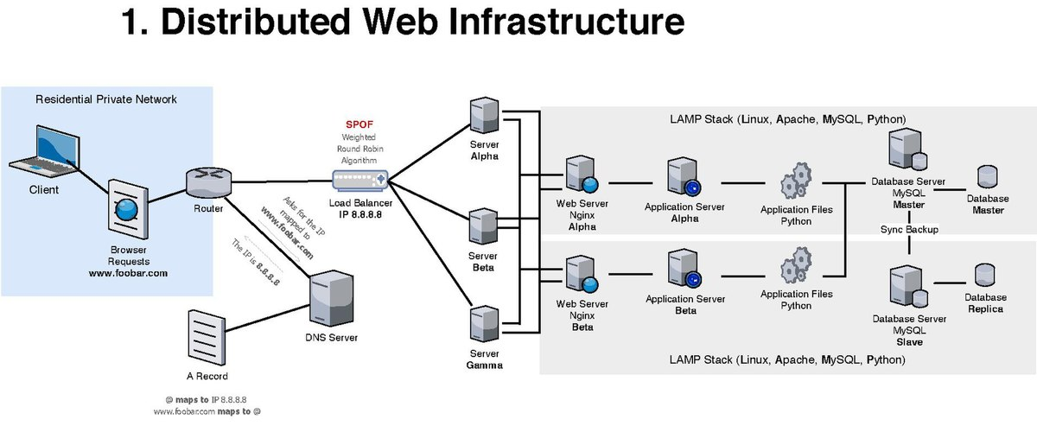
What is
Infrastructure ?
Before we understand Infrastructure as Code. Lets understand the base infrastructure.

Slide 6
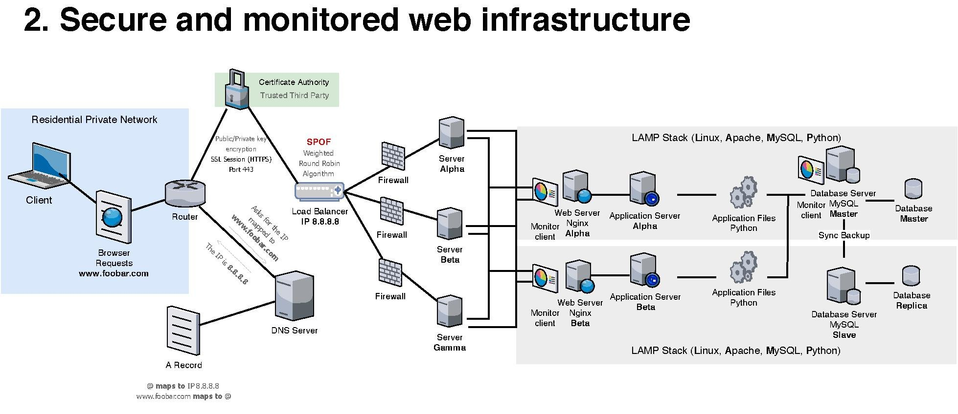
What is
Infrastructure ?
Before we understand Infrastructure as Code. Lets understand the base infrastructure.

Slide 7
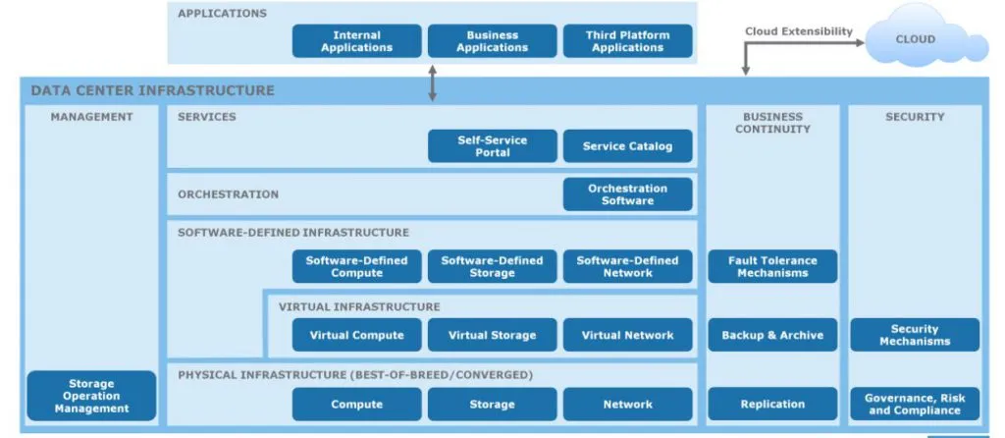
What is
Infrastructure ?
Before we understand Infrastructure as Code. Lets understand the base infrastructure.

Slide 8
Management
Infrastructure
What to do when you planning to migrate infrastructure
For 1 Server
Request
Collect Inputs
Prepare BOM
Procure Hardware
Manually Setup Hardware and Software
Provide Additional Support for Deployment and Configuration Changes
1 month to 3 months
For 10 Servers
Request
Collect Configuration Inputs
Prepare BOM
Procure Hardware
Manually Setup Hardware and Automate Software Installation
Provide Additional Support for Deployments and Configuration Changes
1 month to 3 months

Slide 9
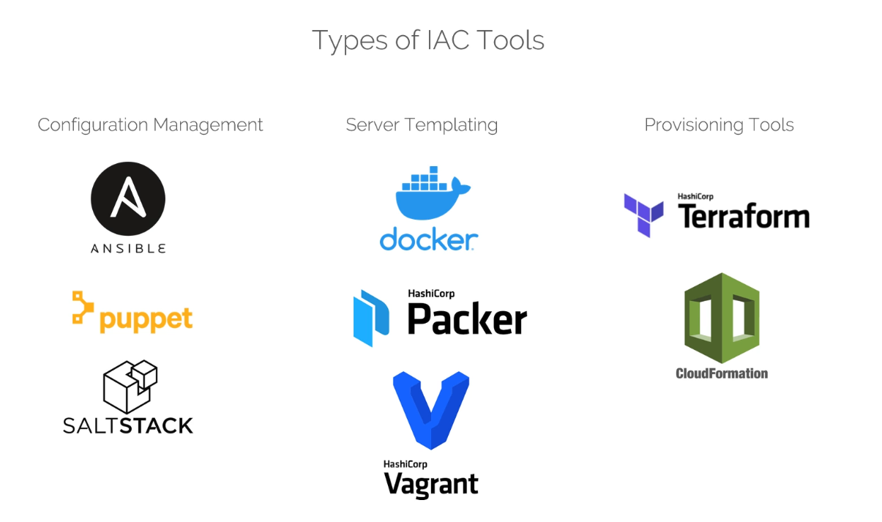
Automation Tools
Infrastructure
Tools you can use for Infrastructure Automation

Slide 10
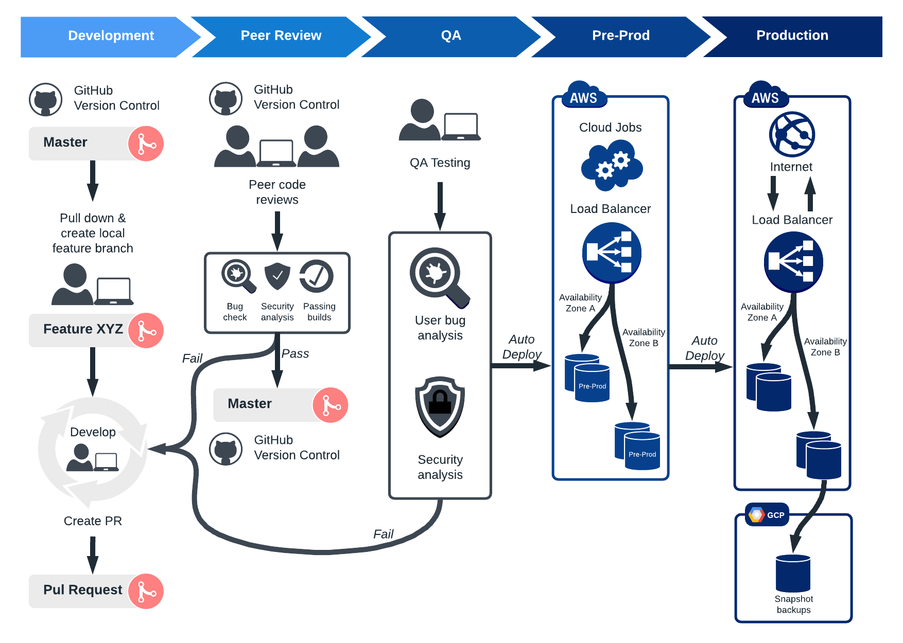
As Code (IAC)
Infrastructure
Tools you can use for Infrastructure Automation

Slide 11
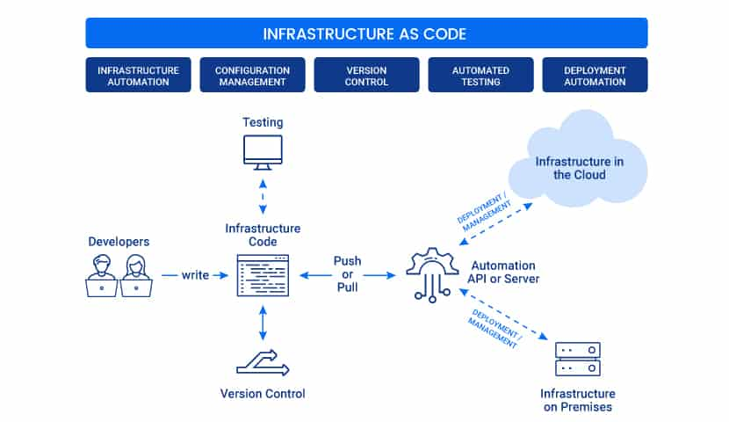
As Code (IAC)
Infrastructure
Tools you can use for Infrastructure Automation

Slide 12
Infrastructure Automation and IaC
Challenges
From Legacy to Modern Infrastructure tamsformation
Issues with Legacy Infra
Scripts to provision infrastructure.
Configurations are managed without any traceability.
Time duration between planning and deployment spanned across months.
Issues with Migrating to Cloud
Different tools for provisioning and upgrades.
Multi-Tenancy
Hybrid Infrastructure

Slide 13

Pre-Requisites
Before we begin practicing
AWS Account
https://youtu.be/bQG5_eJ1qLw

Slide 14
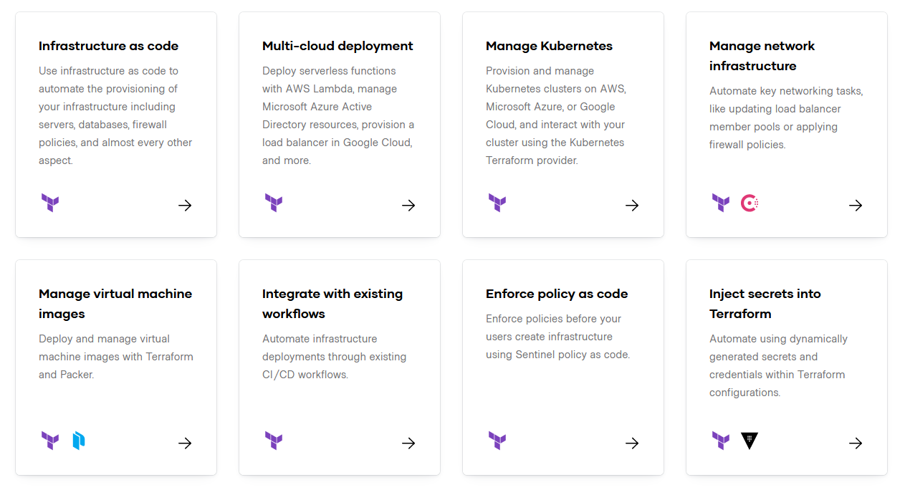
About
Terraform
Hashicorp?
An open-source provisioning tool written in the Go language and created by HashiCorp.
In 2011, AWS introduced CloudFormation.
In July of 2014, we released Terraform 0.1, an open source, cloud-agnostic infrastructure as code solution.
Downloads were mostly stagnant for the first 18 months.
By the end of 2016 — two and a half years after Terraform initially released over 750 contributors, and dozens of providers including Microsoft Azure, Google Cloud, OpenStack, and more. Downloads increased.
2017 - first major cloud partnership — with Microsoft
Extensively popular in Infrastructure as Code Community comprises of more than a thousand Providers and 5,500 modules.

Slide 15
Terraform
About
Hashicorp?
An open-source provisioning tool written in the Go language and created by HashiCorp.
In 2011, AWS introduced CloudFormation.
In July of 2014, we released Terraform 0.1, an open source, cloud-agnostic infrastructure as code solution.
Downloads were mostly stagnant for the first 18 months.
By the end of 2016 — two and a half years after Terraform initially released over 750 contributors, and dozens of providers including Microsoft Azure, Google Cloud, OpenStack, and more. Downloads increased.
2017 - first major cloud partnership — with Microsoft
Extensively popular in Infrastructure as Code Community comprises of more than a thousand Providers and 5,500 modules.

Slide 16
Service
Mapping
Mapping across Various Services in Cloud
https://learn.microsoft.com/en-us/azure/architecture/aws-professional/services
Marketplace
AWS service | Azure service | Description
AWS Marketplace | Azure Marketplace | Easy-to-deploy and automatically configured third-party applications, including single virtual machine or multiple virtual machine solutions.

